Slide 1

SQL Server 2022 Performance Enhancements
Ola Hallengren
Chief Data Platforms Engineer
Saxo Bank

Slide 2



Ola
Hallengren
Chief Data Platforms Engineer
I am working with the databases for the trading systems in Saxo Bank, an investment bank in Copenhagen, Denmark.
I am a Microsoft Data Platform MVP since 2014.
Saxo Bank
ola@hallengren.com
https://ola.hallengren.com

Slide 3
SQL Server 2022 Database Engine Performance Enhancements
Feature | Version
Availability Group Parallel Redo Thread Pool | SQL Server 2022
System page latch (GAM and SGAM) concurrency enhancements | SQL Server 2022
Buffer pool parallel scan | SQL Server 2022
Accelerated Database Recovery (ADR) enhancements | SQL Server 2022
Stack dumps – Multi-threaded, parallel compression | SQL Server 2022 CU8

Slide 4
SQL Server 2022 Database Engine Performance Enhancements - Intelligent query processing (IQP) and Query Store
Feature | Version
Parameter Sensitive Plan optimization | SQL Server 2022
Memory Grant Feedback – Persistence and Percentile | SQL Server 2022
Cardinality estimator feedback | SQL Server 2022
Degree of parallelism (DOP) feedback | SQL Server 2022
Optimized plan forcing | SQL Server 2022
Automatic plan correction enhancements | SQL Server 2022 CU4
Query Store Hints | SQL Server 2022

Slide 5
Availability Group Parallel Redo Thread Pool
Background | In SQL Server 2016, parallel redo was introduced to enhance redo performance for availability groups
Problem | “A SQL Server instance uses up to 100 threads for parallel redo for secondary replicas. Each database uses up to one-half of the total number of CPU cores, but not more than 16 threads per database. If the total number of required threads for a single instance exceeds 100, SQL Server uses a single redo thread for every remaining database.”
Solution | SQL Server 2022 introduces an instance-level shared thread pool for parallel redo The threads are dynamically assigned to the databases, based on the amount of work
How to get it | Out of the box in SQL Server 2022

Slide 6
Availability Group Parallel Redo Thread Pool
Troubleshooting | Here is a script to check the number of redo threads on a secondary replica: SELECT DB_NAME(database_id) AS database_name, COUNT(*) AS number_of_redo_threads FROM sys.dm_exec_requests WHERE command = 'PARALLEL REDO TASK' GROUP BY DB_NAME(database_id)
Real-world experience | On a server with 144 logical cores, the number of redo threads per database is varying between 1 and 17

Slide 7
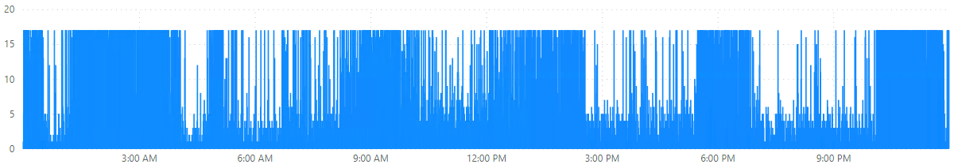
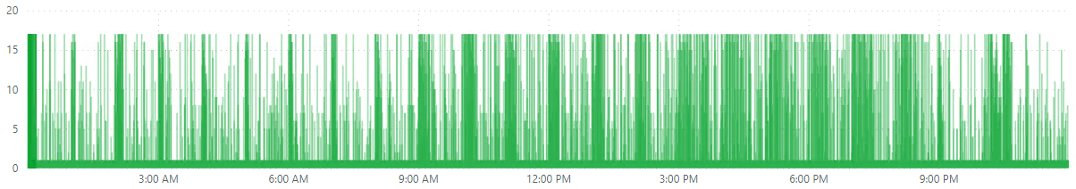
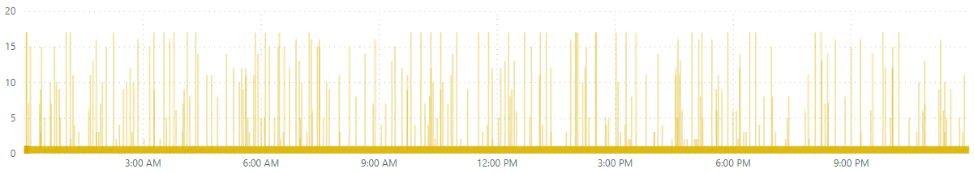
Availability Group Parallel Redo Thread Pool
Number of redo threads
Database 1
Number of redo threads
Database 2
Number of redo threads
Database 3

Slide 8
System page latch (GAM and SGAM) concurrency enhancements
Problem | Page latch contention while allocating/deallocating data pages and extents (especially in tempdb)
Solution | SQL Server 2022 allows concurrent updates to global allocation map (GAM) pages and shared global allocation map (SGAM) pages
How to get it | Out of the box in SQL Server 2022
Real-world experience | We have not had any incidents with PAGELATCH* waits on GAM and SGAM in tempdb on SQL Server 2022

Slide 9
Buffer pool parallel scans
Background | SQL Server does in some cases need to scan the buffer pool. Operations that can trigger a buffer pool scan: Database startup, restart or shutdown Availability group failover Full or differential backup DBCC CHECKDB
Problem | Before SQL Server 2022 buffer pool scans were performed serially Buffer pool scans could then take a long time, on servers with large amount of memory
Solution | SQL Server 2022 introduces parallel buffer pool scans to improve performance
How to get it | Out of the box in SQL Server 2022
Troubleshooting | Extended event buffer_pool_scan_complete

Slide 10
Accelerated Database Recovery (ADR) enhancements
Problem | Database recovery can in some cases take a very long time Rollback of transactions can in some cases take a very long time The transaction log can grow very large, when there are long-running transactions
Solution | SQL Server 2019 introduced a Persistent Version Store (PVS) that provides: Fast and consistent database recovery Instantaneous transaction rollback Aggressive log truncation
How to get it | ALTER DATABASE [DB] SET ACCELERATED_DATABASE_RECOVERY = ON
Further enhancements | SQL Server 2022 has several optimizations, e.g., multi-threaded version cleanup

Slide 11
Accelerated Database Recovery (ADR) enhancements
Risks | A long-running transaction in one database => Persistent Version Store (PVS) is not cleaned up in any database => Performance impact on queries
Troubleshooting | You can monitor the size of the Persistent Version Store (PVS) using sys.dm_tran_persistent_version_store_stats

Slide 12
Stack dumps – Multi-threaded, parallel compression
Background | When an exception or non-yielding scheduler occurs, SQL Server may generate a stack dump You can also generate stack dumps using DBCC STACKDUMP
Problem | On servers with large amount of memory, filtered dumps can be very large and take a long time to generate
Solution | SQL Server 2022 CU8 introduces multi-threaded, compressed stack dumps This can greatly enhance the performance and reduce the size for filtered dumps
How to get it | Install SQL Server 2022 CU8 and enable trace flag 2610
Troubleshooting | Log file SQLDUMPER_ERRORLOG: “sqlservr.exe, zdmp: ParallelDumpTasks speed: Read: 6281547776 bytes, compressed: 527826341 bytes. Read 848 MB/sec, Write 71 MB/sec. Compression rate: 92%. Time taken: 7057 milliseconds.”

Slide 13
Parameter Sensitive Plan optimization (PSP)
Background | Before PSP, a query in SQL Server could only have a single plan in cache
Problem | A plan that is created for one set of parameters, may not be optimal for another set of parameters This is referred to as parameter sniffing
Solution | SQL Server 2022 introduces Parameter Sensitive Plan optimization (PSP) PSP will create a dispatcher plan, and query variants based on predicates Each of the query variants can have a plan in cache
Limitations | PSP will create query variants for up to three predicates PSP only works with equality predicates
How to get it | ALTER DATABASE [DB] SET COMPATIBILITY_LEVEL = 160

Slide 14
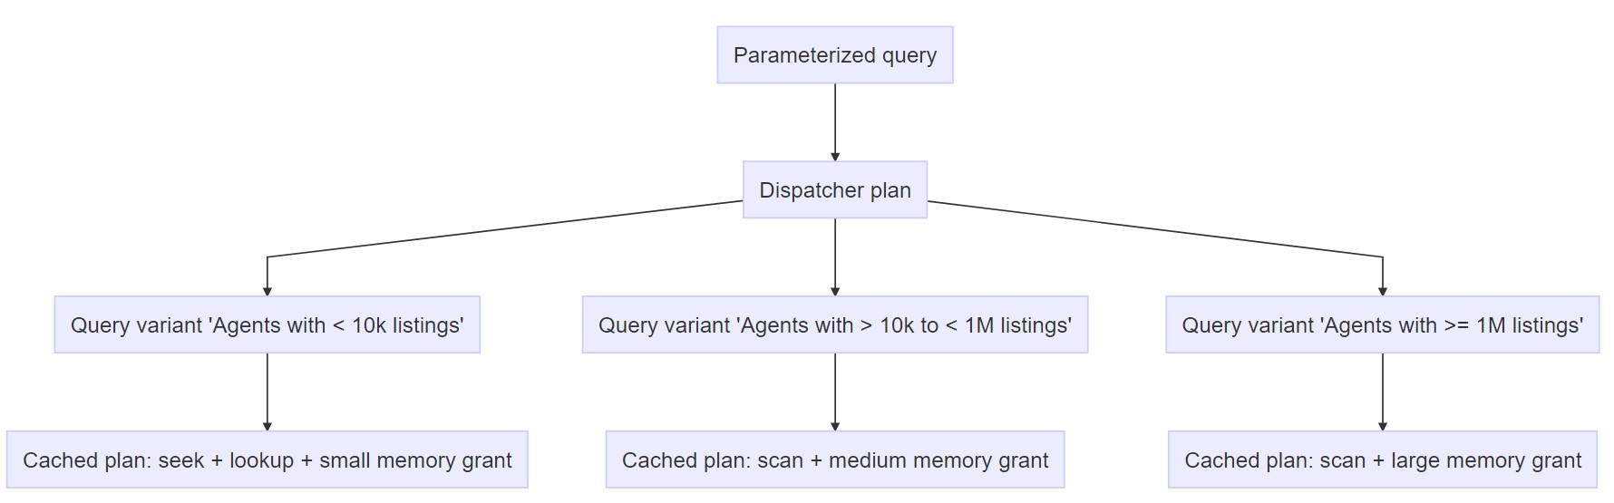
Parameter Sensitive Plan optimization (PSP)

Slide 15
Parameter Sensitive Plan optimization (PSP)
Troubleshooting | Query Store: SELECT * FROM sys.query_store_query_variant

Slide 16
PSP and Query Store - One query from the application
 | SQL Server 2016 – 2019 (no PSP) | SQL Server 2022 (with PSP)
Query texts (query_text_id) | One query text | One query text for the dispatcher + One query text for each query variant
Queries (query_id) | One query | One query for the dispatcher + One query for each query variant They all share the same query_hash
Plans (plan_id) | One or multiple plans for a query | One dispatcher plan for the dispatcher query + One or multiple plans for each query variant

Slide 17
Memory Grant Feedback – Persistence and Percentile
Problem | In some cases SQL Server is allocating too much memory for a query, and in some cases not enough memory (results in spill to tempdb)
Solution | SQL Server 2017 and SQL Server 2019 introduced Memory Grant Feedback, that adjusts the size of the memory allocated for a query based on past executions, through a feedback loop
How to get it | ALTER DATABASE [DB] SET COMPATIBILITY_LEVEL = 140 (or higher)
Further enhancements | SQL Server 2022 comes with two enhancements: Persistence – Persists the memory grants in Query Store SQL Server does not have to start over after a restart or failover Percentile – Will work better when the memory requests are varying between executions
How to get the enhancements | ALTER DATABASE [DB] SET QUERY_STORE = ON (if not already enabled)

Slide 18
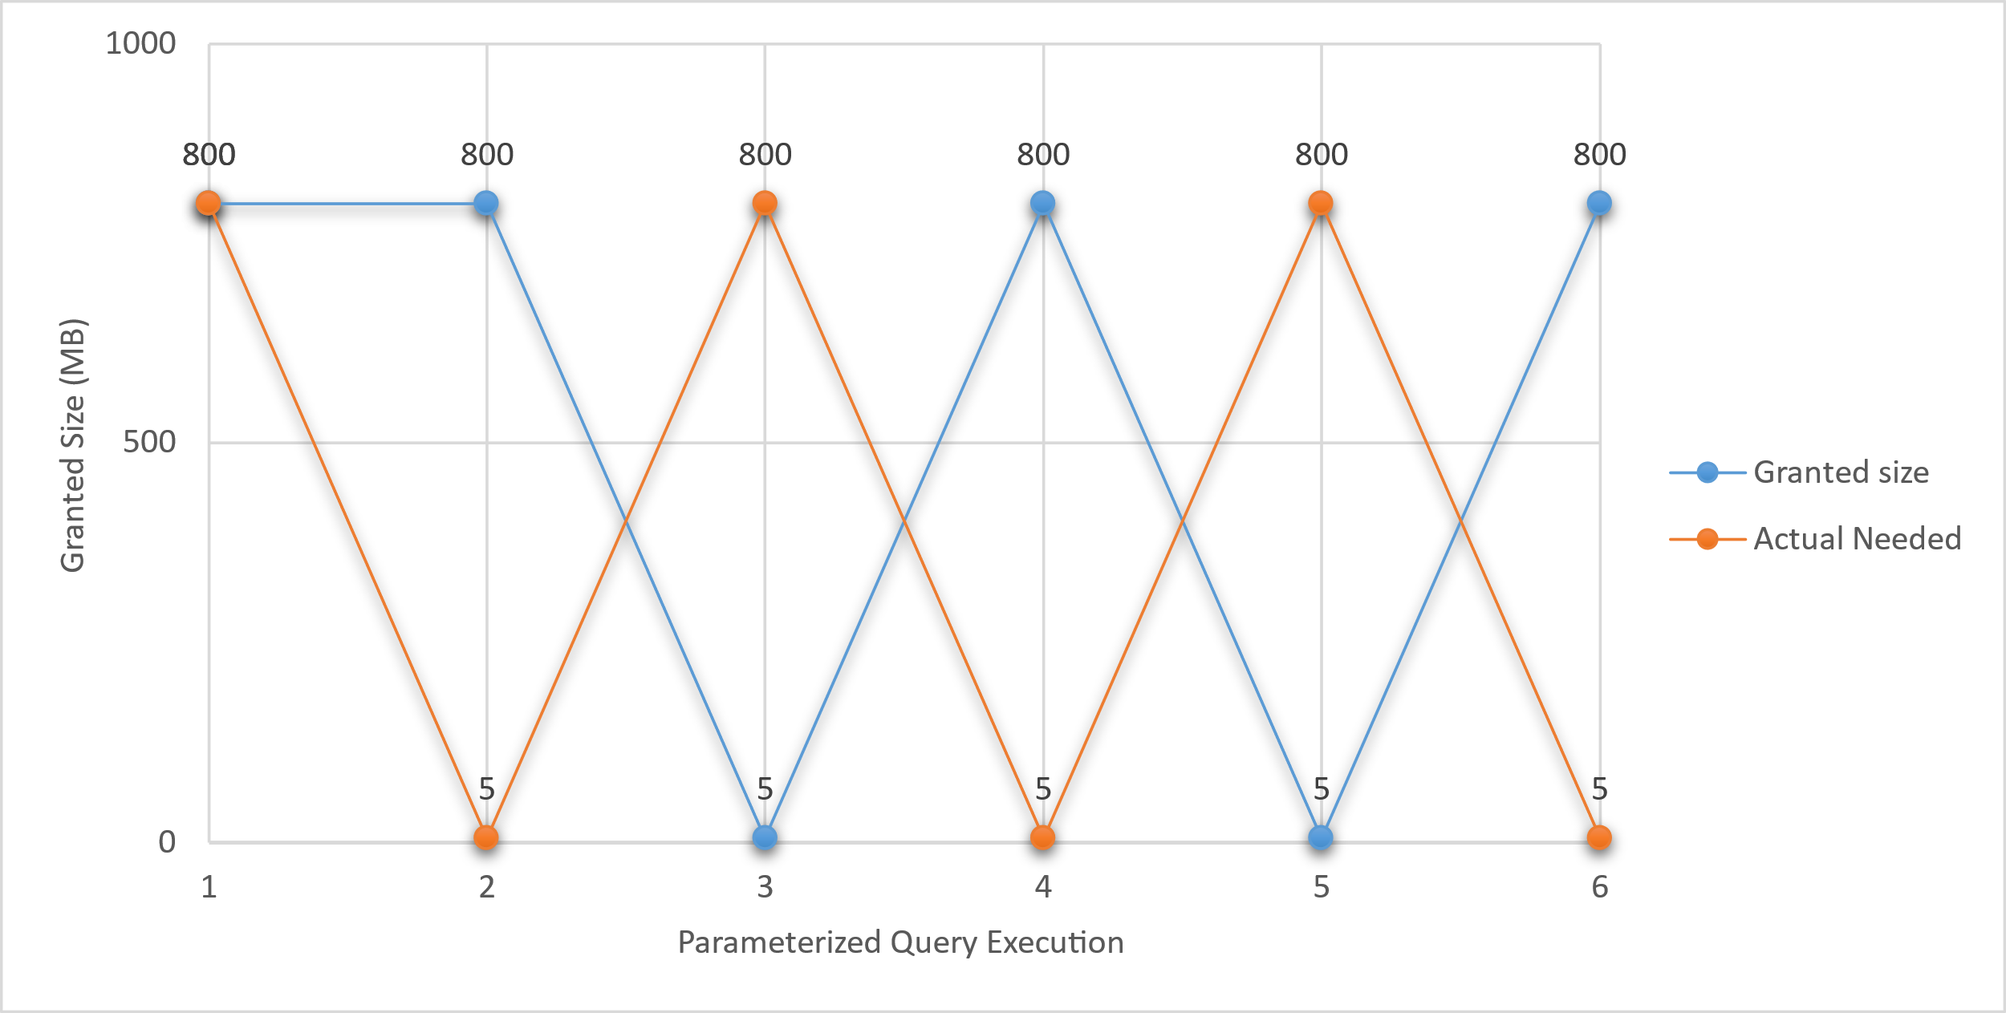
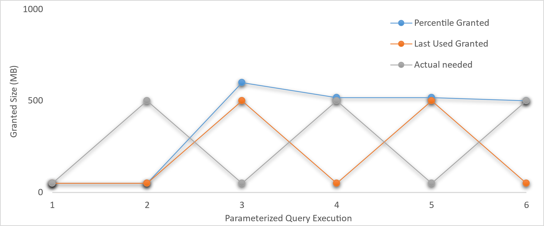
Memory Grant Feedback – A closer look at Percentile
Memory Grant Feedback in SQL Server 2019 – Adjusts based on the most recent execution
Memory Grant Feedback in SQL Server 2022 – Adjusts based on a percentile

Slide 19
Memory Grant Feedback
Troubleshooting | Query Store: SELECT * FROM sys.query_store_plan_feedback WHERE feature_desc = 'Memory Grant Feedback' AND state_desc = 'FEEDBACK_VALID' Extended events: memory_grant_feedback_persistence_update memory_grant_updated_by_feedback

Slide 20
Degree of parallelism (DOP) feedback
Problem | It can happen that for some queries, the parallelism is not efficient
Solution | DOP feedback is dynamically reducing the degree of parallelism for queries where the parallelism is not efficient (based on elapsed time and waits) through a feedback loop
How to get it | ALTER DATABASE SCOPED CONFIGURATION SET DOP_FEEDBACK = ON ALTER DATABASE [DB] SET QUERY_STORE = ON (if not already enabled)
Real-world experience | DOP feedback has, in our environment (large number of databases in production), only kicked in for a single query

Slide 21
Degree of parallelism (DOP) feedback
Troubleshooting | Query Store: SELECT * FROM sys.query_store_plan_feedback WHERE feature_desc = 'DOP Feedback' AND state_desc = 'FEEDBACK_VALID'

Slide 22
Cardinality Estimation Feedback
Background | “Cardinality estimation (CE) is a process used by the query optimizer to estimate the number of rows returned by a query or sub-part of a query. These estimates rely on two underlying things: statistics about the data and a set of assumptions—known as the model.” There are two cardinality estimators: Legacy CE – CE70 Default CE – CE120+ Depending on the data and the query, different assumptions may be optimal
 | Legacy CE – CE70 | Default CE – CE120+ | Other values
Correlation | Fully independent | Partially correlated | Fully correlated
Join Containment | Simple containment | Base containment
Optimizer row goal | OFF | ON

Slide 23
Cardinality Estimation Feedback
Problem | In some cases the assumptions for the default CE, may not be optimal for the data/query This can result in non-optimal plans and bad performance
Solution | CE Feedback is dynamically selecting assumptions that are the most optimal for the query, through a feedback loop It is doing this by applying hints
How to get it | ALTER DATABASE [DB] SET COMPATIBILITY_LEVEL = 160 ALTER DATABASE [DB] SET QUERY_STORE = ON (if not already enabled)
Model | Hint
Simple containment | OPTION(USE HINT('ASSUME_JOIN_PREDICATE_DEPENDS_ON_FILTERS'))

Slide 24
Cardinality Estimation Feedback
Troubleshooting | CE feedback in Query Store SELECT * FROM sys.query_store_plan_feedback WHERE feature_desc = 'CE Feedback' AND state_desc IN('VERIFICATION_PASSED', 'ROLLEDBACK_BY_APRC') CE hints in Query Store SELECT * FROM sys.query_store_query_hints WHERE source_desc = 'CE feedback' Extended Events query_ce_feedback_telemetry

Slide 25
Automatic Plan Correction
Problem | When a plan is recompiled (e.g., because of updated statistics) it can happen that you get a new plan that is non-optimal
Solution | In SQL Server 2017, Automatic Plan Correction was introduced. With this feature enabled, SQL Server will perform a check how the new plan performs after a plan change If the new plan is using significantly more CPU, it will revert back to the last known good plan
How to get it | ALTER DATABASE [DB] SET AUTOMATIC_TUNING (FORCE_LAST_GOOD_PLAN = ON)

Slide 26
Automatic Plan Correction Enhancements
Further enhancements | SQL Server 2022 CU4 has two enhancements: Multiple checks for plan regression, after a plan change (TF 12618) Additional check after 5 minutes (TF 12656)
How to get the enhancements | Install SQL Server 2022 CU4 and enable the trace flags 12618 and 12656
Troubleshooting | Use the extended event automatic_tuning_plan_regression_detection_check_completed (with is_regression_corrected = True) to track plan corrections

Slide 27
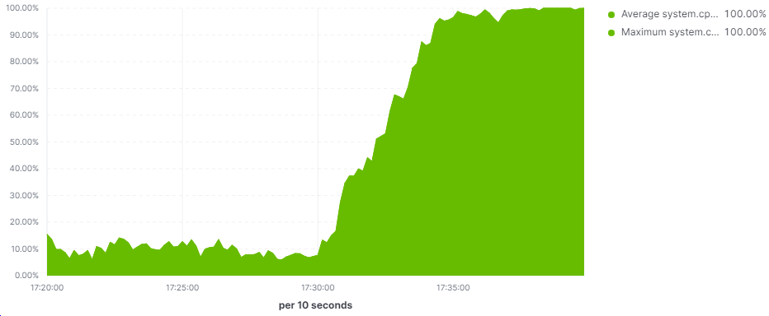
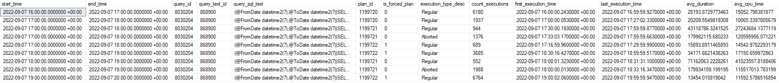
Automatic Plan Correction – Real-world case
CPU

Slide 28
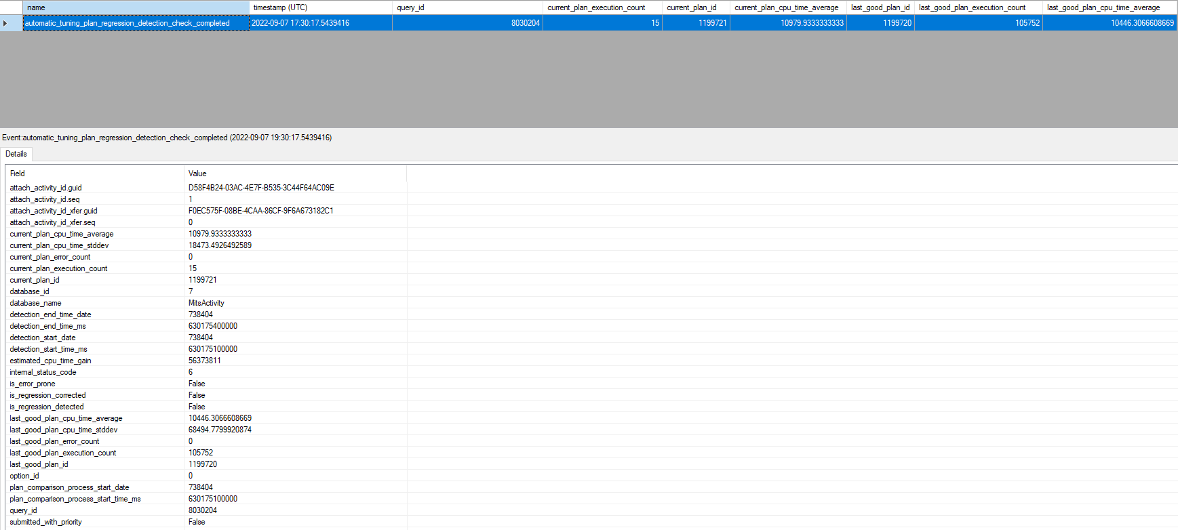
Automatic Plan Correction – Why did it not kick in?

Slide 29
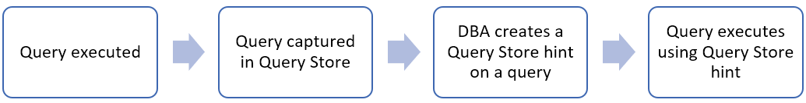
Query Store Hints in SQL Server 2022
Useful when you are not able to modify the query
Supports the hints that are available in the OPTION clause
How it works:
EXECUTE sys.sp_query_store_set_hints @query_id= 1,@query_hints = N'OPTION(RECOMPILE)’
EXECUTE sp_query_store_clear_hints @query_id = 1
Demo

Slide 30
Query Store Hints in Actual Execution Plans
Execution Plan XML attributes:
QueryStoreStatementHintId="2"
QueryStoreStatementHintText="OPTION(RECOMPILE)"
QueryStoreStatementHintSource="User"

Slide 31
Query Store Hints vs Plan Guides
 | SQL Server 2022 Query Store Hints | Plan Guides
Ease of use | Easy | Difficult and error prone
What happens if the query hint can’t be applied? | The query hint is ignored, the query succeeds and the reason is logged to last_query_hint_failure_reason_desc in sys.query_store_query_hints | The query fails with an error
Drop or alter a procedure that is referenced by a Query Store hint / plan guide | Allowed The query hint will stop working (as it will be a new query_id in Query Store) | Not allowed, returns an error
Bonus

Slide 32
Questions?
You can contact me at ola@hallengren.com

Slide 33
Ola Hallengren
ola@hallengren.com
https://ola.hallengren.com

